Slide 1
Software Configuration Management
Subhash Paudel
MSCSKE, IOE, Pulchowk Campus
subhash@achsnepal.edu.np
Notes:
M.Sc. Computer Engineering, Computer System and Knowledge Engineering

Slide 2
Introduction
The art of identifying, organizing and controlling modifications to the software being built
Goal: Maximize the productivity by minimizing mistakes and confusions
Software Configuration Management (SCM) is an umbrella activity, applied throughout the software engineering process.
Key SCM activities are CM planning, change management, version management and system building

Slide 3
Introduction
In System Engineering : No matter where you are in the system life cycle, the system will change, and the desire to change it will persist throughout the life cycle
Fundamental sources of change:
New business or market conditions
New customer needs
Reorganization and/or business downsizing
Budgetary or scheduling
All information produced as part of the software process are collectively called a software configuration

Slide 4
SCM Concepts
New versions of software systems are created as they change:
For different machines/OS;
Offering different functionality;
Tailored for particular user requirements.
Configuration management is concerned with managing evolving software systems:
System change is a team activity;
CM aims to control the costs and effort involved in making changes to a system.

Slide 5
SCM Concepts
Involves the development and application of procedures and standards to manage an evolving software product.
CM may be seen as part of a more general quality management process.
When released to CM, software systems are sometimes called baselines as they are a starting point for further development.

Slide 6
SCM Concepts
A baseline is a milestone in the development of software that marked the delivery of one or more software configuration items.
Example: Design specification -> documented, reviewed ; errors found -> corrected, Approved
Baseline, IEEE defines a baseline as:
A specification or product that has been formally reviewed and agreed upon, that thereafter serves as the basis for further development, and that can be changed only through formal change control procedures

Slide 7
SCM Concepts: Common Baselines
System engineering
Requirement analysis
Software design
Coding
Testing
Release
System specification
Software requirement specification
Design specification
Source code
Test plans/Procedures/Data
Operational system

Slide 8
Software Configuration Item (SCI)
Information created as part of SE process
SCIs used as target in SCM:
System specification
Software project plan
Software requirements specification
Preliminary user manual
Design specification
Source code listing
Test specification
Operation and installation manuals
Executable program
Database description
As-built user manual
Maintenance documents
Standards and procedures for SE

Slide 9
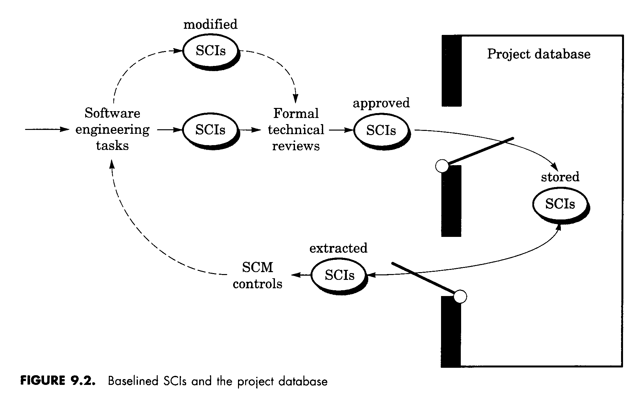
Software Configuration Item (SCI)

Slide 10
SCM Process
Identification
Version control/Baseline
Change control
Configuration auditing
Status reporting

Slide 11
SCM Process
Configuration Identification:
Configuration identification is a method of determining the scope of the software system.
With the help of this step, you can manage or control something even if you don't know what it is.
It is a description that contains the CSCI type (Computer Software Configuration Item), a project identifier and version information.
Instead of naming a File login.php its should be named login_v1.2.php where v1.2 stands for the version number of the file
Instead of naming folder "Code" it should be named "Code_D" where D represents code should be backed up daily.

Slide 12
SCM Process
Baseline:
A baseline is a formally accepted version of a software configuration item.
It is designated and fixed at a specific time while conducting the SCM process.
It can only be changed through formal change control procedures.
In simple words, baseline means ready for release.

Slide 13
SCM Process
Change Control:
Change control is a procedural method which ensures quality and consistency when changes are made in the configuration object.
In this step, the change request is submitted to software configuration manager.
It manages changes and making configuration items available during the software lifecycle
Configuration Status Accounting:
Configuration status accounting tracks each release during the SCM process.
This stage involves tracking what each version has and the changes that lead to this version.

Slide 14
SCM Process
Configuration Audits and Reviews:
Configuration auditing is conducted by auditors by checking that defined processes are being followed and ensuring that the SCM goals are satisfied.
To verify compliance with configuration control standards. auditing and reporting the changes made
SCM audits also ensure that traceability is maintained during the process.
Ensures that changes made to a baseline comply with the configuration status reports
Validation of completeness and consistency

Slide 15
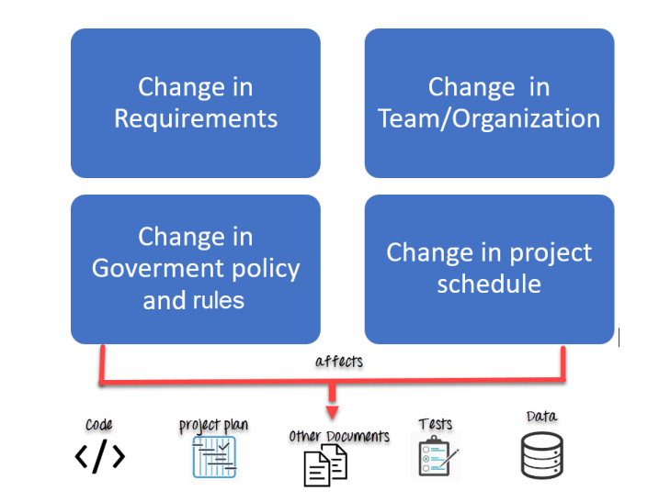
Why SCM

Slide 16
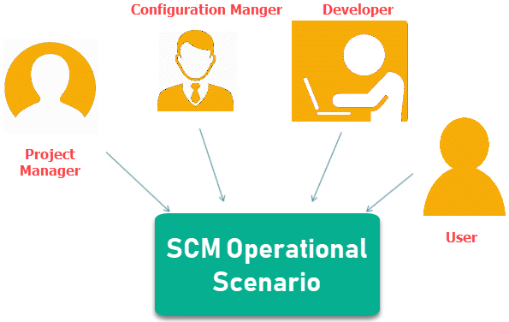
Participants on SCM Process

Slide 17
Participants on SCM Process
Configuration Manager
Configuration Manager is the head who is Responsible for identifying configuration items.
CM ensures team follows the SCM process
He/She needs to approve or reject change requests
Developer
The developer needs to change the code as per standard development activities or change requests. He is responsible for maintaining configuration of code.
The developer should check the changes and resolves conflicts

Slide 18
Participants on SCM Process
Auditor
The auditor is responsible for SCM audits and reviews.
Need to ensure the consistency and completeness of release.
Project Manager:
Ensure that the product is developed within a certain time frame
Monitors the progress of development and recognizes issues in the SCM process
Generate reports about the status of the software system
Make sure that processes and policies are followed for creating, changing, and testing
User
The end user should understand the key SCM terms to ensure he has the latest version of the software

Slide 19
Change Management Process

Slide 20
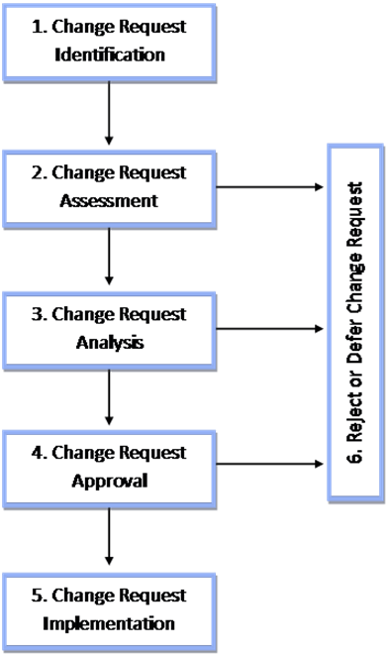
Steps involved in the Change Process

Slide 21
SCM Planning (SCMP, IEEE 828-1990)
Introduction
Describes purpose, scope of application, key terms and references
Management (Who?)
Identifies the responsibilities and authorities for accomplishing the planned configuration management activities
Activities (What?)
Identifies the activities to be performed in applying to the project.
Schedule (When?)
Establishes the sequence and coordination of the SCM activities with project mile stones.
Resources (How?)
Identifies tools and techniques required for the implementation of the SCMP
Maintenance
Identifies activities and responsibilities on how the SCMP will be kept current during the life-cycle of the project.

Slide 22
Working with Peers: Centralized Workflow
Example scenario: Two developers clone from the hub and both make changes
The first developer to push his changes back up can do so with no problems
The second developer must merge in the first one’s work before pushing changes up, so as not to overwrite the first developer’s changes
Notes:
Chacon & Straub: “Pro Git”, page 152

Slide 23
Working with a Managed Team
Example scenario:
1. The configuration manager pushes the current version to the central project repository
2. A contributor clones that repository and makes changes
3. The contributor pushes the changed version to his own public repository
4. The contributor notifies the configuration manager requesting to pull changes
5. The configuration manager adds the contributor’s repository as a remote and merges locally
6. The configuration manager pushes merged changes to the central project repository
Notes:
Chacon & Straub: “Pro Git”, page 152

Slide 24
Git Commands Summary

Slide 25
SCM Summary
Configuration Management best practices helps organizations to systematically manage, organize, and control the changes in the documents, codes, and other entities during the Software Development Life Cycle.
The primary goal of the SCM process is to increase productivity with minimal mistakes
The main reason behind configuration management process is that there are multiple people working on software which is continually updating. SCM helps establish concurrency, synchronization, and version control.
A baseline is a formally accepted version of a software configuration item

Slide 26
SCM Summary
Change control is a procedural method which ensures quality and consistency when changes are made in the configuration object.
Configuration status accounting tracks each release during the SCM process
Software Configuration audits verify that all the software product satisfies the baseline needs
Project manager, Configuration manager, Developer, Auditor, and user are participants in SCM process
The SCM process planning begins at the early phases of a project.
Git, Team foundation Sever and Ansible are few popular SCM tools.

